Slide 1
Project of sprint 1
Name : Bhagyashri Arun Mundhe
Emp id : 46234770
Bach : . Net core azure batch 3

Slide 2
Case study
1.Create a web api in DOT NET
2.Create database in Sql server
3.Create web app in angular
features:-
User Section
1.User can register and login
2.He can purchase product through COD
3.User can see the product
Admin
Section
1.Admin can login and add categories
2.can see all orders placed by the customer and customer details
3.admin can add products

Slide 3
Database
sql
Web Api
Ecommerce
Web
api
Angular part of
Frist –sample –project
In EcommercewebApi

Slide 4
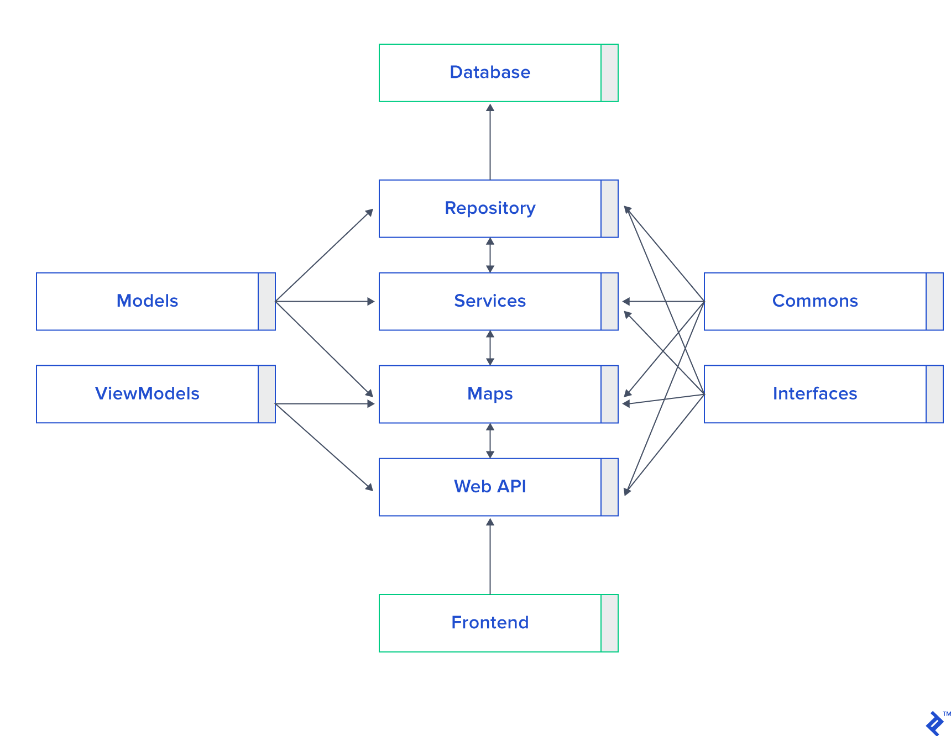

Slide 5
conclusion
I think this article will be very helpful for the beginners who are want to learn AngularJS, WebApi,SQL-SERVER Data First. I am not good at English, If I mistake anything please forgive me. Thanks for having patience.

